Slide 2
Topics
Sequences
Lists
  List Slicing
  Finding Items in Lists with the in Operator
  List Methods and Useful Built-in Functions
  Copying Lists
  Processing Lists
  List Comprehensions
  Two-Dimensional Lists
Tuples
Plotting List Data with the matplotlib Package

Slide 3
Sequences
Sequence: an object that contains multiple items of data
  The items are stored in sequence one after another
Python provides different types of sequences, including lists and tuples
  The difference between these is that a list is mutable, and a tuple is immutable

Slide 4
Lists
A list is an object that can contain multiple data items (also called elements).
  Format: list = [item1, item2, etc.]
  Example: students = [101, 'Shia', 102, 'Jenny’]
  Can hold items of different types
Lists are mutable, which means that their contents can be changed during a program’s execution.
Lists are dynamic data structures, meaning that items may be added to them or removed from them.

Slide 5
Lists
Python also has a built-in list() function that can convert certain types of objects to lists.
Example: numbers = list(range(5))
  Here, range function returns an iterable, which is an object that holds a series of values (0-4 in this case) that can be iterated over. The list function then converts this iterable object into a list.
Another example: n =list()
  Here, an empty list is created (n = [])

Slide 6
The Repetition Operator
When the operand on the left side of the * symbol is a sequence (such as a list) and the operand on the right side is an integer, it becomes the repetition operator.
The repetition operator makes multiple copies of a list and joins them all together.
Here is the general format: list * n
Example: [0] * 5
  This returns: [0, 0, 0, 0, 0]

Slide 7
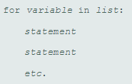
Using a for loop with lists
Syntax:
Example:
numbers = [1, 2, 3, 4]
for num in numbers:
print(num)

Slide 8
Indexing
You can use an index (0-based) to access elements in a list.
Note that the length function returns the length of a list.
In the following program, I use indexing first with a for loop and then with a while loop to access and display elements in a list.
numbers = [10, 20, 30, 40]
for i in range(len(numbers)):
print(numbers[i])
j = 0
while j < len(numbers):
print(numbers[j])
j += 1

Slide 9
Indexing
You can also use negative indexes with lists to identify element positions relative to the end of the list.
The Python interpreter adds negative indexes to the length of the list to determine the element position.
The index −1 identifies the last element in a list, −2 identifies the next to last element, and so forth.
numbers = [10, 20, 30, 40]
print(numbers[-1]) #displays 40

Slide 10
List are Mutable
Since lists are mutable, you can change an element in the list.
Below, we change the second element from 20 to 50
    numbers = [10, 20, 30, 40]
    numbers[1] = 50
    print(numbers) #[10, 50, 30, 40]
However, the following statement will give an error as index value 4 does not exist:
number[4] = 60

Slide 11
List are Mutable
As another example, to fill a list with five values, I first create a list of length 5, initialize it to 0, and then fill it with random numbers between 0 and 9 (inclusive).
import random
numbers = [0] * 5 # Creates [0, 0, 0, 0, 0]
for i in range(len(numbers)):
numbers[i] = random.randint(0, 9)
print(numbers)

Slide 12
Concatenating Lists
You can concatenate one list with another using the + operator.
  list1 = [1, 2, 3, 4]
  list2 = [5, 6, 7, 8]
  list3 = list1 + list2 # [1, 2, 3, 4, 5, 6, 7, 8]

Slide 13
List Slicing
List slicing is the process of taking a span of elements from within a list.
  Syntax: list_name[start : end]
  The expression returns a list containing a copy of the elements from start up to (but not including) end.
  Example:

Slide 14
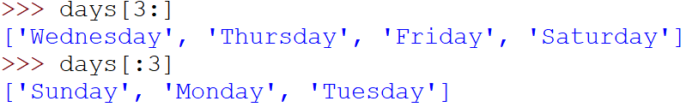
List Slicing
If you leave out the end index in a slicing expression, Python uses the length of the list as the end index.
If you leave out the start index in a slicing expression, Python uses 0 as the starting index.

Slide 15


List Slicing
Slicing expressions can also have step value.
You can also use negative numbers as indexes in slicing expressions to reference positions relative to the end of the list. Python adds a negative index to the length of a list to get the position referenced by that index.

Slide 16
List Slicing
Invalid indexes do not cause slicing expressions to raise an exception. For example:
If the end index specifies a position beyond the end of the list, Python will use the length of the list instead.
If the start index specifies a position before the beginning of the list, Python will use 0 instead.
If the start index is greater than the end index, the slicing expression will return an empty list.

Slide 17
Finding Items in Lists with the in Operator
You can use the in operator to determine whether an item is contained in a list
  General format: item in list
  Returns True if the item is in the list, or False if it is not in the list
Similarly, you can use the not in operator to determine whether an item is not in a list
student_id = [101, 102, 103, 104, 105]
#Check if an id is in the list
if 107 in student_id:
print('Found')
else:
print('Not Found')

Slide 18
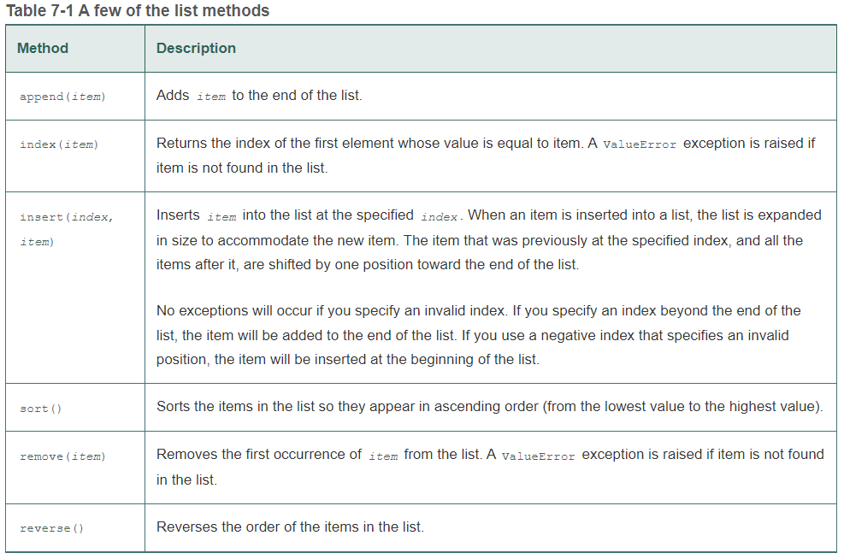
List Methods

Slide 19
List Methods
>>> student_id = [101, 102, 103, 104]
>>> student_id.append(105)
>>> student_id
[101, 102, 103, 104, 105]
>>> student_id.index(103)
2
>>> student_id.insert(2, 1010)
>>> student_id
[101, 102, 1010, 103, 104, 105]
>>> student_id.sort()
>>> student_id
[101, 102, 103, 104, 105, 1010]
>>> student_id.remove(1010)
>>> student_id
[101, 102, 103, 104, 105]
>>> student_id.reverse()
>>> student_id
[105, 104, 103, 102, 101]

Slide 20
Useful Built-in Functions for Lists
del statement: removes an element from a specific index in a list (note that remove method removes a specific item)
  >>> student_id = [101, 102, 103, 104]
  >>> del student_id[2]
  >>> student_id
  [101, 102, 104]
student_id.remove(103)

Slide 21
Useful Built-in Functions for Lists
sum function: returns the sum of the values in a numeric list
min and max functions: returns the item that has the lowest or highest value in a list
Examples
  >>> numbers = [3, 1, 2, 4]
  >>> sum(numbers)
  10
  >>> max(numbers)
  4
  >>> min(numbers)
  1

Slide 22
Randomly Selecting List Elements
The random module provides a function named choice that randomly selects an element in a list.
    import random
    names = ['Jenny', 'Kelly', 'Chloe', 'Aubrey']
    winner = random.choice(names)
    print(winner)
The function choices can be used to return multiple randomly selected elements from the list
  Takes two arguments, the list and k=n where n is the number of elements to be returned and returns a list
    import random
    names = ['Jenny', 'Kelly', 'Chloe', 'Aubrey']
    winner = random.choices(names, k=3)
    print(winner) # ['Chloe', 'Chloe', 'Jenny']

Slide 23
Randomly Selecting List Elements
The list that is returned from the choices function sometimes contains duplicate elements.
If you want to randomly select unique elements, use the random module’s sample function instead.
  import random
  names = ['Jenny', 'Kelly', 'Chloe', 'Aubrey']
  winner = random.sample(names, k=2)
  print(winner)

Slide 24
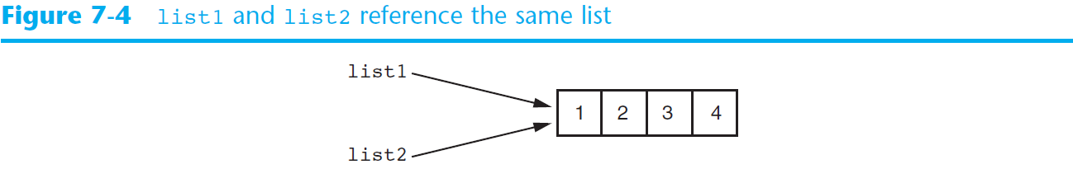
Copying Lists
Note that assigning one list to another list simply makes both lists reference the same object in memory.
  # Create a list.
  list1 = [1, 2, 3, 4]
  # Assign the list to the list2 variable.
  list2 = list1

Slide 25
Copying Lists
Suppose you wish to make a copy of the list, so that list1 and list2 reference two separate but identical lists.
Two methods to do this:
    Creating a new empty list and using a for loop to add a copy of each element from the original list to the new list
    Creating a new empty list and concatenating the old list to the new empty list

Slide 26
Copying Lists
Using a for loop
  # Create a list with values.
  list1 = [1, 2, 3, 4]
  # Create an empty list.
  list2 = []
  # Copy the elements of list1 to list2.
  for item in list1:
  list2.append(item)
  print(list2)

Slide 27
Copying Lists
Using concatenation
  # Create a list with values.
  list1 = [1, 2, 3, 4]
  # Create a copy of list1.
  list2 = [] + list1
  print(list2)

Slide 28
Passing a List to a Function
def main():
numbers = [2, 1, 5, 4]
print(get_total(numbers))
def get_total(value_list):
total= 0
for i in value_list:
total += i
return total
if __name__ == '__main__':
main()

Slide 29
Returning a List from a Function
def main():
numbers = get_values()
print(numbers)
def get_values():
values = []
for i in range(5):
num = int(input('Enter a number: '))
values.append(num)
return values
if __name__ == '__main__':
main()

Slide 30
Working with Lists and Files
Python file objects have a method named writelines that writes an entire list to a file.
  The write method, on the other hand, writes a string to a file (not a list).
A drawback to the writelines method, however, is that it does not automatically write a newline ('\n') at the end of each item.

Slide 31
Working with Lists and Files
# This program uses the writelines method to save
# a list of strings to a file.
def main():
# Create a list of strings.
cities = ['New York', 'Kathmandu', 'Addis Ababa', 'Havana']
# Write the list to a file.
with open('cities.txt', 'w') as outfile:
outfile.writelines(cities)
# Call the main function.
if __name__ == '__main__':
main()
File content: New YorkKathmanduAddis AbabaHavana

Slide 32
Working with Lists and Files
An alternative approach is to use a for loop to write each element of the list to a new line.
# This program saves a list of strings to a file.
def main():
# Create a list of strings.
cities = ['New York', 'Kathmandu', 'Addis Ababa', 'Havana']
# Write the list to a file.
with open('cities.txt', 'w') as outfile:
for item in cities:
outfile.write(item + '\n')
# Call the main function.
if __name__ == '__main__':
main()

Slide 33
Working with Lists and Files
File objects in Python have a method named readlines that returns a file’s contents as a list of strings.
Each line in the file will be an item in the list.
The items in the list will include their terminating newline character, which in many cases you will want to strip.

Slide 34
Working with Lists and Files
# This program reads a file's contents into a list.
def main():
# Read the contents of the file into a list.
with open('cities.txt', 'r') as infile:
cities = infile.readlines()
print(cities) # ['New York\n', 'Kathmandu\n', 'Addis Ababa\n', 'Havana\n']
# Strip the \n from each element.
for index in range(len(cities)):
cities[index] = cities[index].rstrip('\n')
# Print the contents of the list.
print(cities) # ['New York', 'Kathmandu', 'Addis Ababa', 'Havana']
# Call the main function.
if __name__ == '__main__':
main()

Slide 35
Working with Lists and Files
Note that you write a string to a file and read lines from a file as a string.
So, when working with numbers and file IO, you need to perform the appropriate conversion.
You use the str function to convert a number to a string before writing it to a file.
When reading a number from a file, you convert the string that you read from a file to a number using int or float function.

Slide 36
Working with Lists and Files
Notice the use of str() to convert numbers to string before writing to a file.
# This program saves a list of test scores to a file.
def main():
# Create a list of strings.
scores = [85, 75, 95, 100, 45]
# Write the list to a file.
with open('scores.txt', 'w') as outfile:
for item in scores:
outfile.write(str(item) + '\n')
# Call the main function.
if __name__ == '__main__':
main()

Slide 37
Working with Lists and Files
Notice the use of str() to convert numbers to string before writing to a file.
# This program saves a list of test scores to a file.
def main():
# Create a list of strings.
scores = [85, 75, 95, 100, 45]
# Write the list to a file.
with open('scores.txt', 'w') as outfile:
for item in scores:
outfile.write(str(item) + '\n')
# Call the main function.
if __name__ == '__main__':
main()

Slide 38
Working with Lists and Files
Notice the use of int() to convert string to integer after reading from a file.
# This program reads a file's numeric contents into a list.
def main():
# Read the contents of the file into a list.
with open('scores.txt', 'r') as infile:
scores = infile.readlines()
# Strip the \n from each element.
for index in range(len(scores)):
scores[index] = int(scores[index].rstrip('\n'))
# Print the contents of the list.
print(scores) # [85, 75, 95, 100, 45]
# Call the main function.
if __name__ == '__main__':
main()

Slide 39
List Comprehensions
List comprehension is a concise expression that creates a new list by iterating over the elements of an existing list.
General Format:
[result_expression iteration_expression]

Slide 40

List Comprehensions
The following code uses a for loop to make a copy of a list:
The following code uses a list comprehension to make a copy of a list:
list1 = [1, 2, 3, 4]
list2 = []
for item in list1:
list2.append(item)
Each time the for loop iterates, the target variable item is assigned the value of an element.
At the end of each iteration, the value of the result expression is appended to the new list.
list1 = [1, 2, 3, 4]
list2 = [item for item in list1]

Slide 41

List Comprehensions
Another Example
list1 = [1, 2, 3, 4]
list2 = [item**2 for item in list1]
Each time the iteration expression iterates, the target variable item is assigned the value of an element.
At the end of each iteration, the value of the result expression item**2 is appended to list2.
After this code executes, list2 will contain the values [1, 4, 9, 16].

Slide 42
List Comprehensions
Another Example: Suppose you have a list of strings, and you want to create a second list that contains the lengths of all the strings in the first list.
str_list = [‘Tian', ‘Bishop', ‘Ng']
len_list = [len(s) for s in str_list]
In the list comprehension, the iteration expression is for s in str_list and the result expression is len(s).
After this code executes, len_list will contain the values [4, 6, 2].

Slide 43
List Comprehensions
You can use an if clause in a list comprehension to select only certain elements when processing a list
For example, suppose a list contains integers and you want to make a second list that contains only the integers from the first list that are less than 10.
list1 = [1, 12, 2, 20, 3, 15, 4]
list2 = []
for n in list1:
if n < 10:
list2.append(n)
Works the same as…
list1 = [1, 12, 2, 20, 3, 15, 4]
list2 = [item for item in list1 if item < 10]

Slide 44
List Comprehensions
Another Example: Only select last names that are less than six characters.
last_names = [Theodosiou', 'Smith’, Aizenberg', 'Jones']
short_names = [name for name in last_names if len(name) < 6]
The list comprehension, which iterates over the last_names list, has an if clause that selects only the elements that are less than 6 characters long.
After this code executes, short_names will contain ['Smith', 'Jones']

Slide 45
List Comprehensions
Taking multiple inputs from the user using list comprehension
x, y, z = [int(x) for x in input("Enter three values: ").split()]
print("First Number is: ", x)
print("Second Number is: ", y)
print("Third Number is: ", z)
Assuming you enter “1 2 3”, the input function returns this string. The split function then converts this string into a list of three items. The for loop iterates through this list, converts each item to an int and assigns it to the three variables.
The above example takes input separated by spaces. In case you wish to take input separated by comma (, ), you can pass comma as an argument to the split function:
x, y, z = [int(x) for x in input("Enter three values: ").split(“,”)]

Slide 46
Two-Dimensional Lists
Two-dimensional list: a list that contains other lists as its elements
  Also known as nested list
  Common to think of two-dimensional lists as having rows and columns
  Useful for working with multiple sets of data
To process data in a two-dimensional list, you need to use two indexes

Slide 47
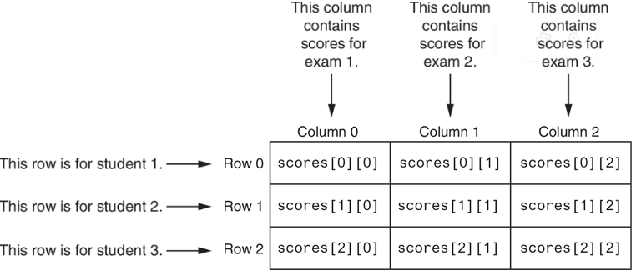
Two-Dimensional Lists
Suppose, you need to store exam scores for three students and each student takes three exams

Slide 48
Two-Dimensional Lists
scores = [[50, 70, 60], [55, 85, 75], [35, 85, 25]]
print(scores[1]) # displays [55, 85, 75]
print(scores[2][1]) # displays 85
To display the entire content of scores:
    for row in scores:
    for element in row:
    print(element)

Slide 49
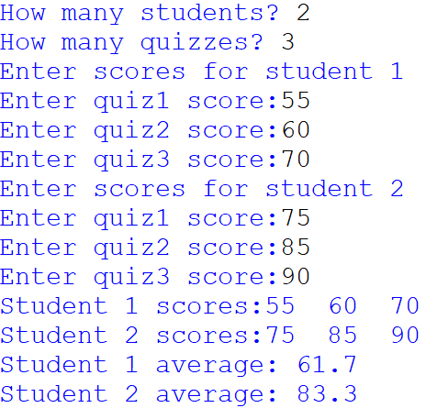
Two-Dimensional Lists
Let’s write a program that will ask the user to enter the number of students and the number of quizzes.
Then, the program creates a 2-D list with required number of rows representing students and columns representing scores in quizzes.
Finally, the program displays all student scores and the student average in quizzes.

Slide 50
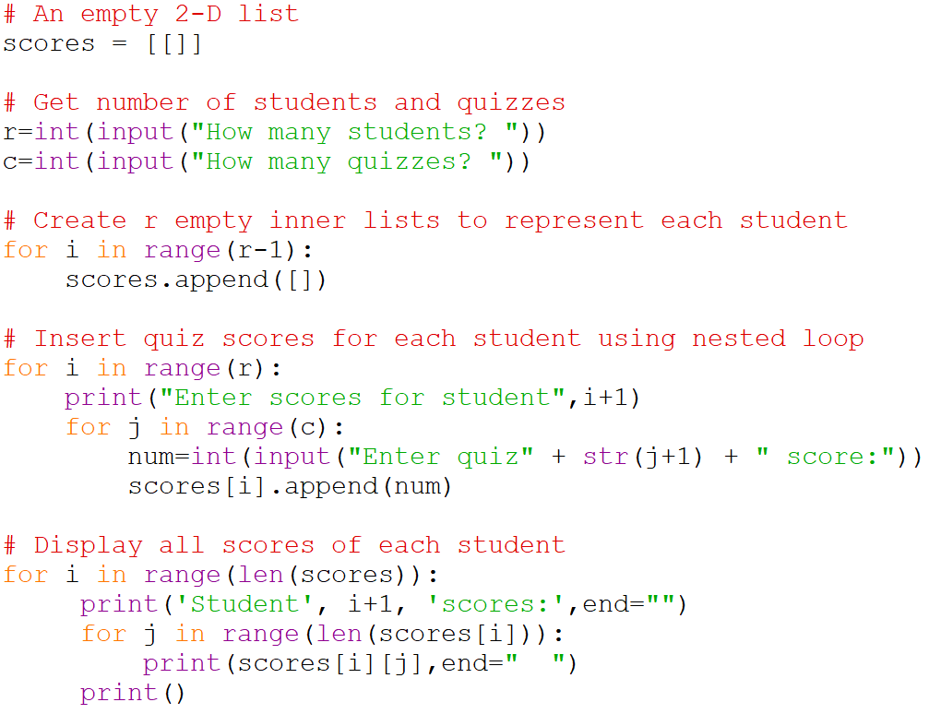
Two-Dimensional Lists

Slide 51
Entire Code from Previous Slide
# An empty 2-D list
scores = [[]]
# Get number of students and quizzes
r=int(input("How many students? "))
c=int(input("How many quizzes? "))
# Create r empty inner lists to represent each student
for i in range(r-1):
scores.append([])
# Insert quiz scores for each student using nested loop
for i in range(r):
print("Enter scores for student",i+1)
for j in range(c):
num=int(input("Enter quiz" + str(j+1) + " score:"))
scores[i].append(num)
# Display all scores of each student
for i in range(len(scores)):
print('Student', i+1, 'scores:',end="")
for j in range(len(scores[i])):
print(scores[i][j],end=" ")
print()
# Display the average quiz score of each student
Complete the code to find the average quiz score of each student.

Slide 52
Tuples
A tuple is an immutable sequence, which means that its contents cannot be changed.
When you create a tuple, you enclose its elements in a set of parentheses.
Like, lists, tuples support indexing.
names = ('Kokou', 'Nelson', 'Ashley')
for n in names:
print(n)
names = ('Kokou', 'Nelson', 'Ashley')
for i in range(len(names)):
print(names[i])

Slide 53
Tuples
Tuples support all the same operations as lists, except those that change the contents of the list.
Tuples support the following:
    Subscript indexing for retrieving elements
    Methods such as index
    Built in functions such as len, min, max
    Slicing expressions
    The in, +, and * operators
Tuples do not support methods such as append, remove, insert, reverse, and sort.

Slide 54
Tuples
If you want to create a tuple with just one element, you must write a trailing comma after the element’s value, as shown here:
  value = (1,) # Creates a tuple with one element.
If you omit the comma, you will not create a tuple but just a variable:
  value = (1) # Creates an integer.

Slide 55
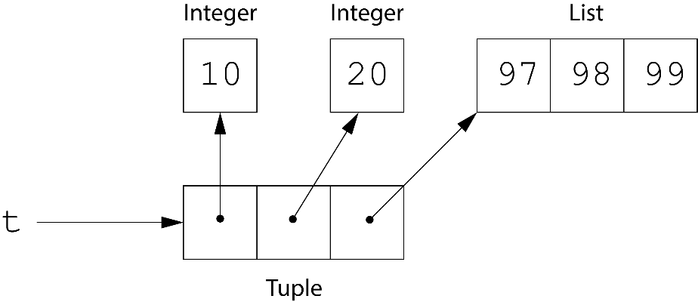
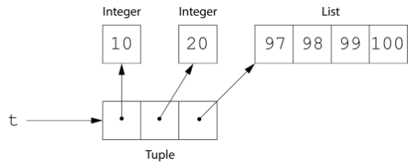
Storing Mutable Objects in a Tuple
When working with tuples, remember that although the tuple’s elements cannot be changed, it is possible to store a mutable object in a tuple.
When a mutable object is stored in a tuple, the mutable object can be changed.
t = (10, 20, [97, 98, 99])
t[2].append(100)

Slide 56
Converting between Lists and Tuples
You can use the built-in list() function to convert a tuple to a list, and the built-in tuple() function to convert a list to a tuple.
  t = (10, 20, 30)
  print(t) # (10, 20, 30)
  l = list(t)
  print(l) # [10, 20, 30]
  l = ['one', 'two', 'three']
  print(l) # ['one', 'two', 'three']
  t = tuple(l)
  print(t) # ('one', 'two', 'three')

Slide 57
Tuples - Advantages
Processing a tuple is faster than processing a list, so tuples are good choices when you are processing lots of data, and that data will not be modified.
Another reason is that tuples are safe. Because you are not allowed to change the contents of a tuple, you can store data in one and rest assured that it will not be modified (accidentally or otherwise) by any code in your program.

Slide 58
Plotting Data with matplotlib
The matplotlib package is a library for creating two-dimensional charts and graphs.
It is not part of the standard Python library, so you will have to install it separately, after you have installed Python on your system.

Slide 59
Plotting Data with matplotlib
To install matplotlib on a Windows system, open a Command Prompt window and enter this command:
pip install matplotlib
To install matplotlib on a Mac or Linux system, open a Terminal window and enter this command:
sudo pip3 install matplotlib
To verify the package was installed, start IDLE and enter this command:
>>> import matplotlib
If you don't see any error messages, you can assume the package was properly installed.

Slide 60
Plotting Data with matplotlib
The matplotlib package contains a module named pyplot that you will need to import.
Use the following import statement to import the module and create an alias named plt:
import matplotlib.pyplot as plt
We are using an alias here as this allows us to use plt prefix to call any function in matplotlib.pyplot module instead of having to type matplotlib.pyplot before the name of each function call which can become tiresome.
  For example, plt.plot(arguments...) instead of matplotlib.pyplot.plot(arguments...)

Slide 61
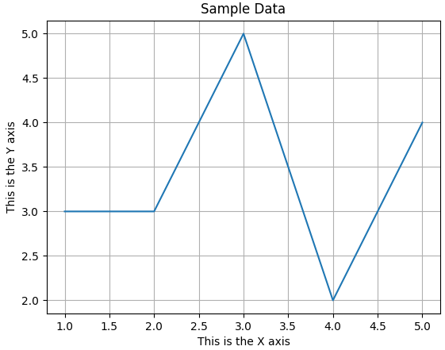
Plotting a Line Graph with the plot Function
Use the plot function to create a line graph that connects a series of data points with straight lines.
The plot function builds the line graph in memory but does not display it.
To display the graph, you call the show function.
You can add a title to your graph with the title function.
You can also add descriptive labels to the X and Y axes with the xlabel and ylabel functions.
You can also add a grid to the graph by calling the grid function, passing True as an argument.

Slide 62
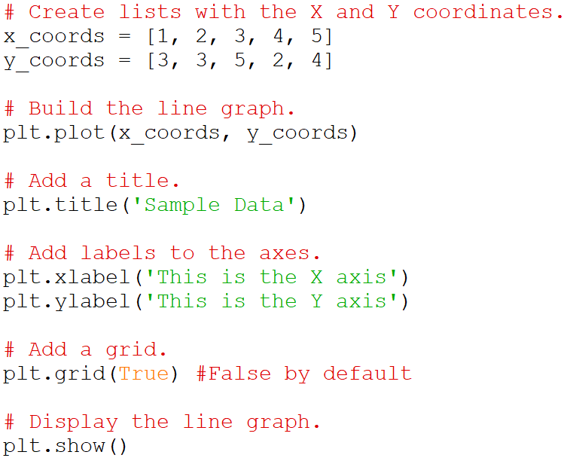
Plotting a Line Graph with the plot Function

Slide 63
Plotting a Line Graph with the plot Function
# This program displays a simple line graph.
import matplotlib.pyplot as plt
def main():
# Create lists with the X and Y coordinates.
x_coords = [1, 2, 3, 4, 5]
y_coords = [3, 3, 5, 2, 4]
# Build the line graph.
plt.plot(x_coords, y_coords)
# Add a title.
plt.title('Sample Data')
# Add labels to the axes.
plt.xlabel('This is the X axis')
plt.ylabel('This is the Y axis')
# Add a grid.
plt.grid(True) #False by default
# Display the line graph.
plt.show()
# Call the main function.
if __name__ == '__main__':
main()
Entire Code from previous slide

Slide 64
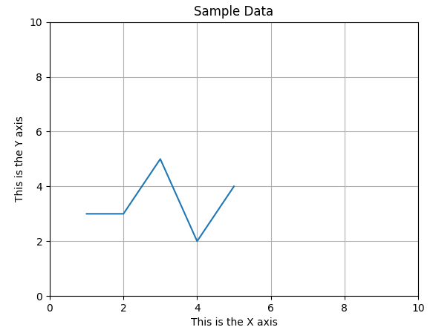
Plotting a Line Graph with the plot Function
By default, the X and Y axis begins at the lowest X and Y coordinates in your set of data points, and it ends at the highest X and Y coordinates in your set of data points.
For example, in the previous code, the lowest X coordinate is 1, and the highest X coordinate is 5.
You can change the lower and upper limits of the X and Y axes by calling the xlim and ylim functions.
  # Set the axis limits.
  plt.xlim(xmin=0, xmax=10)
  plt.ylim(ymin=0, ymax=10)

Slide 65
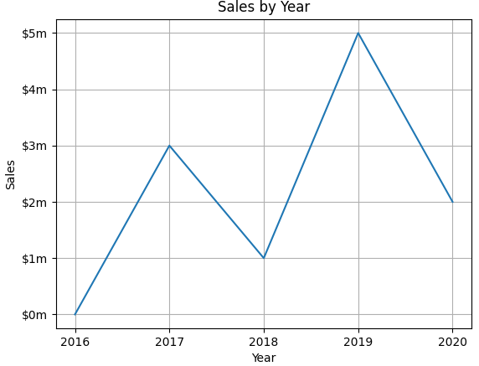
Plotting a Line Graph with the plot Function
You can customize each tick mark's label with the xticks and yticks functions.
These functions each take two lists as arguments.
  The first argument is a list of tick mark locations
  The second argument is a list of labels to display at the specified locations.
plt.xticks([0, 1, 2, 3, 4], ['2016', '2017', '2018', '2019', '2020'])
plt.yticks([0, 1, 2, 3, 4, 5], ['$0m', '$1m', '$2m', '$3m', '$4m', '$5m'])

Slide 66
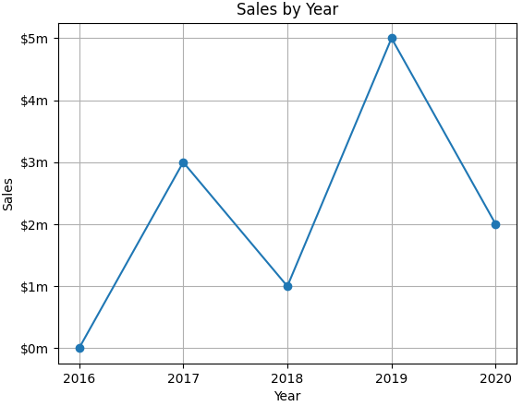
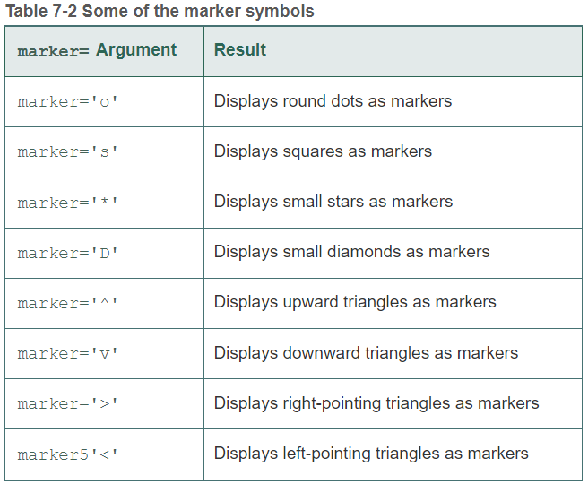
Plotting a Line Graph with the plot Function
Displaying Markers at the Data Points
You can display a round dot as a marker at each data point in your line graph by using the keyword argument marker='o' with the plot function.

Slide 67
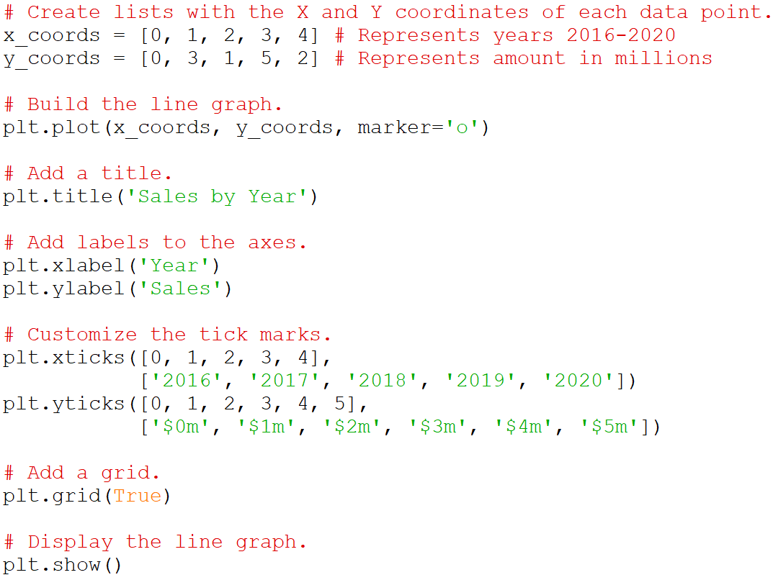
Plotting a Line Graph with the plot Function

Slide 68
Plotting a Line Graph with the plot Function
# This program displays a simple line graph.
import matplotlib.pyplot as plt
def main():
# Create lists with the X and Y coordinates of each data point.
x_coords = [0, 1, 2, 3, 4] # Represents year
y_coords = [0, 3, 1, 5, 2] # Represents amount in millions
# Build the line graph.
plt.plot(x_coords, y_coords, marker='o')
# Add a title.
plt.title('Sales by Year')
# Add labels to the axes.
plt.xlabel('Year')
plt.ylabel('Sales')
# Customize the tick marks.
plt.xticks([0, 1, 2, 3, 4],
['2016', '2017', '2018', '2019', '2020'])
plt.yticks([0, 1, 2, 3, 4, 5],
['$0m', '$1m', '$2m', '$3m', '$4m', '$5m'])
# Add a grid.
plt.grid(True)
# Display the line graph.
plt.show()
# Call the main function.
if __name__ == '__main__':
main()

Slide 69
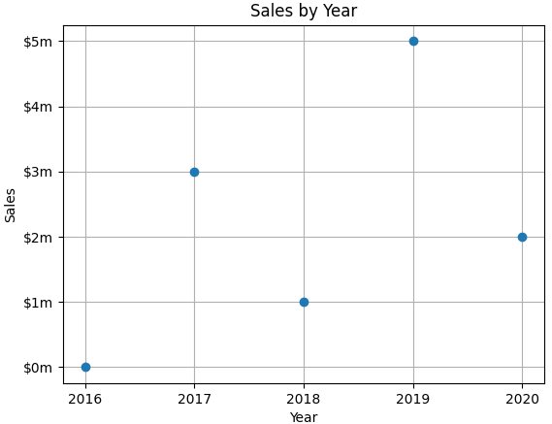
Plotting a Line Graph with the plot Function
If you pass the marker character as a positional argument (instead of passing it as a keyword argument), the plot function will draw markers at the data points, but it will not connect them with lines.
plt.plot(x_coords, y_coords, 'o')

Slide 70
Plotting a Bar Chart
Use the bar function in the matplotlib.pyplot module to create a bar chart.
Each bar represents a value, and the bar’s height is proportional to the value that the bar represents.
The bar function needs two lists: one with the X coordinates of each bar’s center, and another with the heights of each bar, along the Y axis.

Slide 71
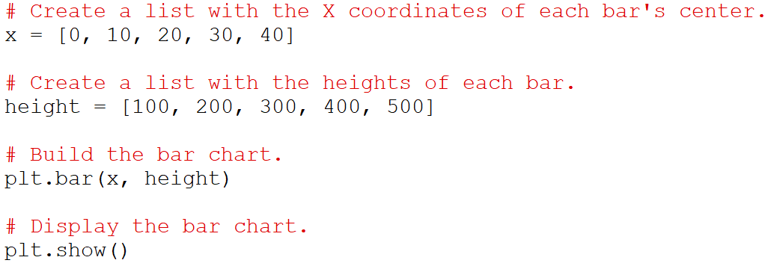
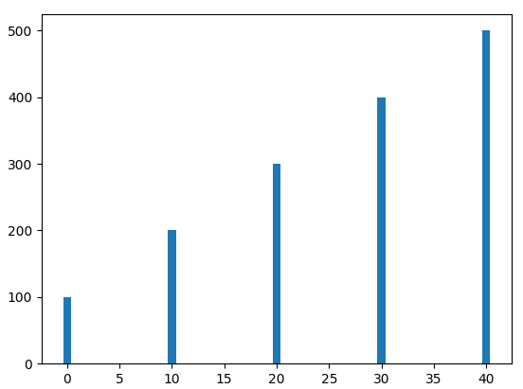
Plotting a Bar Chart

Slide 72
Plotting a Bar Chart
The default width of each bar in a bar graph is 0.8 along the X axis. You can change the bar width by using the width argument with the bar function.
The x coordinates represent the center of each bar with the given width (o.8 by default). You can change the x coordinates to represent the left edge by using the align argument (align = ‘edge’).

Slide 73
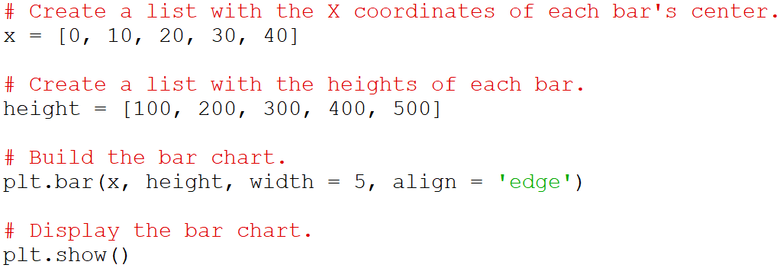
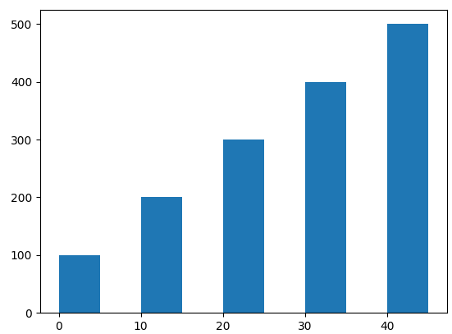
Plotting a Bar Chart
Here, the x coordinates represent the left edge of the bar, and the width is 5.

Slide 74
Plotting a Bar Chart
# This program displays a simple bar chart.
import matplotlib.pyplot as plt
def main():
# Create a list with the X coordinates of each bar's center.
x = [0, 10, 20, 30, 40]
# Create a list with the heights of each bar.
height = [100, 200, 300, 400, 500]
# Build the bar chart.
plt.bar(x, height, width = 5, align = 'edge')
# Display the bar chart.
plt.show()
# Call the main function.
if __name__ == '__main__':
main()
Entire code from previous example

Slide 75
Plotting a Bar Chart
The bar function has a color parameter that you can use to change the colors of the bars.
The argument that you pass into this parameter is a tuple containing a series of color codes.
  The first bar will be red, the second bar will be green and so on.
plt.bar(left_edges, heights, color=('r', 'g', 'b', 'w', 'k'))
Color Code | Corresponding Color
'b' | Blue
'g' | Green
'r' | Red
'c' | Cyan
'm' | Magenta
'y' | Yellow
'k' | Black
'w' | White

Slide 76
Plotting a Bar Chart
Use the xlabel and ylabel functions to add labels to the X and Y axes.
Use the title function to add a title to the chart.
Use the xticks function to display custom tick mark labels along the X axis
Use the yticks function to display custom tick mark labels along the Y axis.

Slide 77
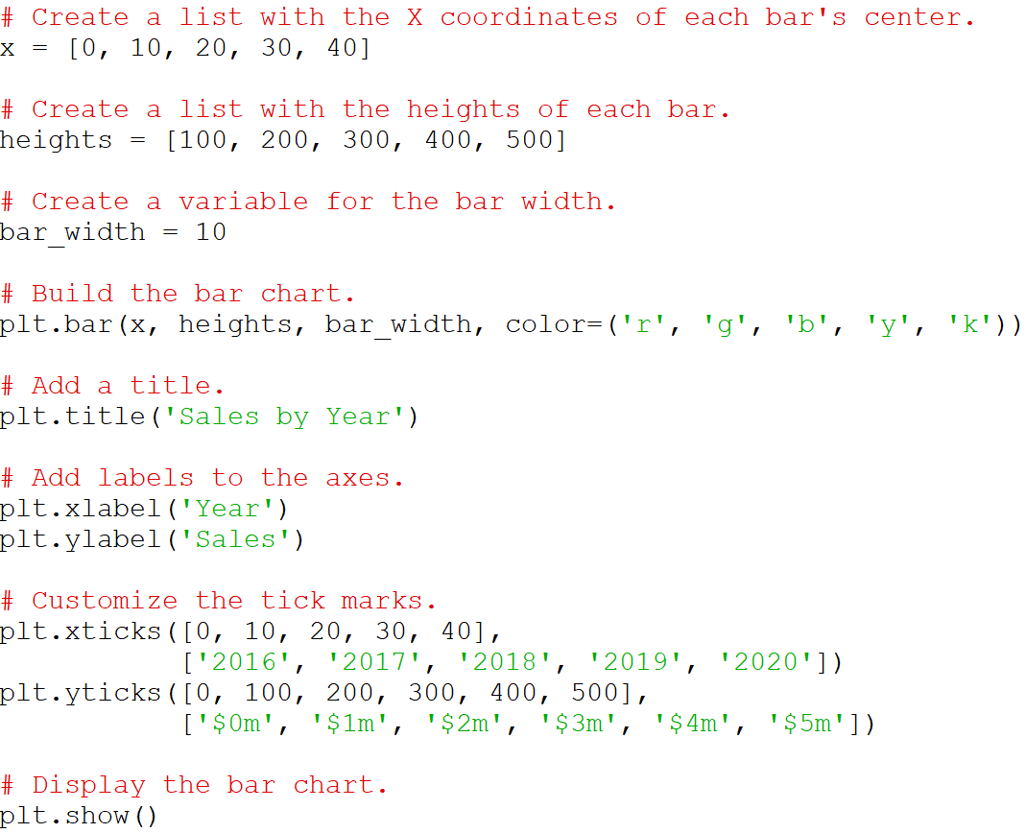
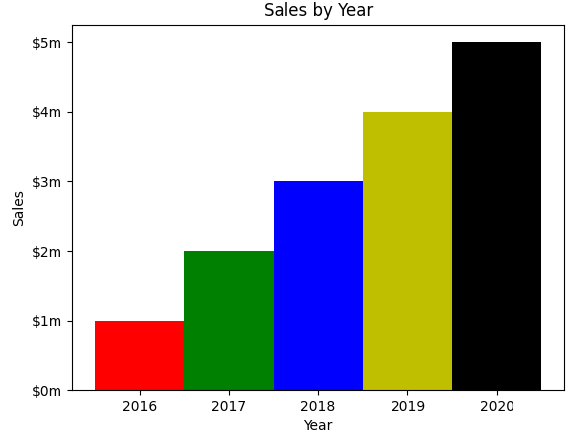
Plotting a Bar Chart

Slide 78
Plotting a Bar Chart
# This program displays a sales chart.
import matplotlib.pyplot as plt
def main():
# Create a list with the X coordinates of each bar's center.
x = [0, 10, 20, 30, 40]
# Create a list with the heights of each bar.
heights = [100, 200, 300, 400, 500]
# Create a variable for the bar width.
bar_width = 10
# Build the bar chart.
plt.bar(x, heights, bar_width, color=('r', 'g', 'b', 'y', 'k'))
# Add a title.
plt.title('Sales by Year')
# Add labels to the axes.
plt.xlabel('Year')
plt.ylabel('Sales')
# Customize the tick marks.
plt.xticks([0, 10, 20, 30, 40],
['2016', '2017', '2018', '2019', '2020'])
plt.yticks([0, 100, 200, 300, 400, 500],
['$0m', '$1m', '$2m', '$3m', '$4m', '$5m'])
# Display the bar chart.
plt.show()
# Call the main function.
if __name__ == '__main__':
main()
Entire code from previous example

Slide 79
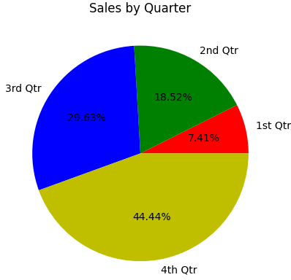
Plotting a Pie Chart
A pie chart is a graph that shows a circle that is divided into slices.
The circle represents the whole, and the slices represent percentages of the whole.

Slide 80
Plotting a Pie Chart
You use the pie function in matplotlib.pyplot module to create a pie chart.
Example: matplotlib.pyplot.pie([20, 30, 10, 40])
When you call the pie function, you pass a list of values as an argument.
  The sum of the values will be used as the value of the whole.
  Each element in the list will become a slice in the pie chart.
  The size of a slice represents that element's value as a percentage of the whole.

Slide 81
Plotting a Pie Chart
The pie function has a labels parameter that you can use to display labels for the slices in the pie chart.
  The argument that you pass into this parameter is a list containing the desired labels, as strings.
The pie function automatically assigns color to the slices.
  You can specify a different set of colors, however, by passing a tuple of color codes as an argument to the pie function’s colors parameter.
The autopct parameter can be used to label the slices with their numeric value.
There are several more parameters, please refer to the online documentation.

Slide 82
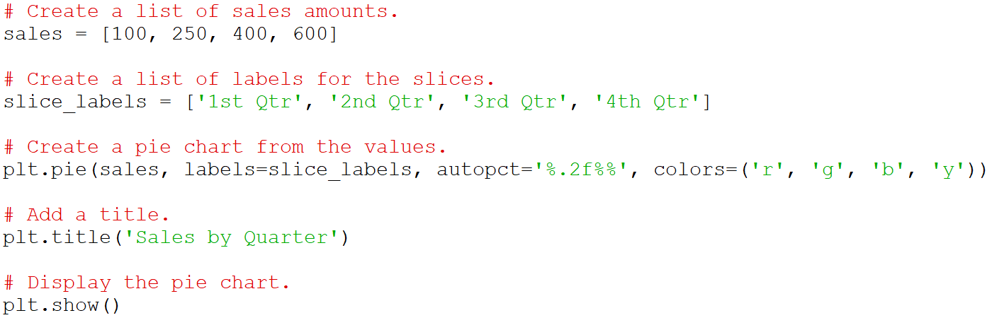
Plotting a Pie Chart

Slide 83
Plotting a Pie Chart
# This program displays a simple pie chart.
import matplotlib.pyplot as plt
def main():
# Create a list of sales amounts.
sales = [100, 250, 400, 600]
# Create a list of labels for the slices.
slice_labels = ['1st Qtr', '2nd Qtr', '3rd Qtr', '4th Qtr']
# Create a pie chart from the values.
plt.pie(sales, labels=slice_labels, autopct='%.2f%%', colors=('r', 'g', 'b', 'y'))
# Add a title.
plt.title('Sales by Quarter')
# Display the pie chart.
plt.show()
# Call the main function.
if __name__ == '__main__':
main()
Entire code from previous slide

Slide 84
Summary
This chapter covered:
  Lists, including:
    Repetition and concatenation operators
    Indexing
    Techniques for processing lists
    Slicing and copying lists
    List methods and built-in functions for lists
    Two-dimensional lists
  Tuples
  Plotting charts and graphs with the matplotlib Package

